Slide 1
Filling in the margins:
The use of queer theory,
feminist standpoint theory, and
critical race theory
to build inclusive archival collections
Jen LaBarbera
Notes:
Archives are often thought of as these objective sites of historic fact; what’s in the archives makes up this authoritative record of what happened in history.
In reality, though, archives are these perpetual construction sites that tell the stories of history, and archivists have the responsibility of deciding what stories get told in that repository - archivists get to decide what becomes part of the historic record and what is not included. For the most part, many archives mostly hold what some people call “dead white guy history;” that is, history that reflects the stories of the powerful and not the stories of regular people.
ASIDE: recent archives & archivists listserv blow-up that became a debate between those who believe that our field is a fully neutral one, that doesn’t question the white supremacist patriarchy that
Since the early 1970s, archivists have followed history fields to attempt to cover a history that’s more of a social history; documenting regular people rather than just people in power. In recent years - especially in the past year - more archivists ahve begun to consider the theoretical bases of building those more inclusive collections, but so far, there is no one accepted theoretical framework for this work. In this paper, I will suggest a new theoretical framework for approaching this practice.
What this is: a suggested framework (way of thinking, intellectual approach)
What this is NOT: a prescriptive paper, a how-to, a case study of best practices

Slide 2
Theoretical framework
critical race theory
queer theory
feminist standpoint theory
Notes:
include WHY we need a new theoretical framework (archivists are working to build inclusive collections now, but there’s no structure for their work) and WHY these three (instead of just “critical theory” in general & instead of including the myriad of other critical / postmodern theories) - personal expertise, representative of wide variety of critical theoretical frameworks and can be expanded to be inclusive of all underrepresented / underdocumented groups
LIS field is generally very practice-focused, and spends very little time on developing and exploring theoretical frameworks for its work.
GENERAL OVERVIEW OF THEORIES
To speak very generally, postmodern, poststructural, and critical theories encourage archivists to consider the ways that society - and, with that, history - is constructed by individual decisions, biases, and subjectivity
Queer Theory: Queer theory grew out of feminist theory in the early 1990s, and builds from foundations in poststructural and postmodern theories
queer theory destabilizes the traditional meanings and definitions of things, especially gender and sexuality - even more specifically, oppressed genders and sexualities.
(feminist theory roots)
feminist standpoint theory requires the archivist to consider their own social situation - their own privileges and oppressions - before making any assumptions or decisions about including materials from marginalized groups in their collections.
(Marxist/class critical roots)
critical race theory removes whiteness as the default assumption, instead placing people of color at the center of any conversations or decisions about archival collection development.
(critical legal studies roots)
INTERSECTIONALITY these three theories, of course, intersect in meaningful ways, both in their theoretical frameworks (having common roots in critical theory and postmodernism) and in the real implications for the people that archives interact with (e.g. the papers of a queer woman of color activist being accessioned by a straight white male archivist)

Slide 3
Research questions
What type of theoretical approaches do archivists use in inclusive archives?
Do archivists already apply principles of critical race theory, feminist standpoint theory, or queer theory in their collection development work?
What does it look like when these theoretical frameworks are applied to archival practice?
What challenges do archivists identify that may be alleviated by the application of a combination of feminist standpoint theory, queer theory, and critical race theory to archival practice?

Slide 4
Methods - Overview
Semi-structured interviews with practicing archivists Purposive sample -- archivists from archives that are:
in the U.S.
affiliated with higher education institutions
have specialized regional or subject-specific collections outside of university/institutional archives
Notes:
interview questions covered what topics?
specify what kinds of archives ended up being in your sample; also mention the other 10ish that were left out (saved for later dissertation)

Slide 5
Methods - Data analysis
Notes:
coding: interview transcripts mapped to theoretical frameworks
two coders to ensure validation of analysis

Slide 6
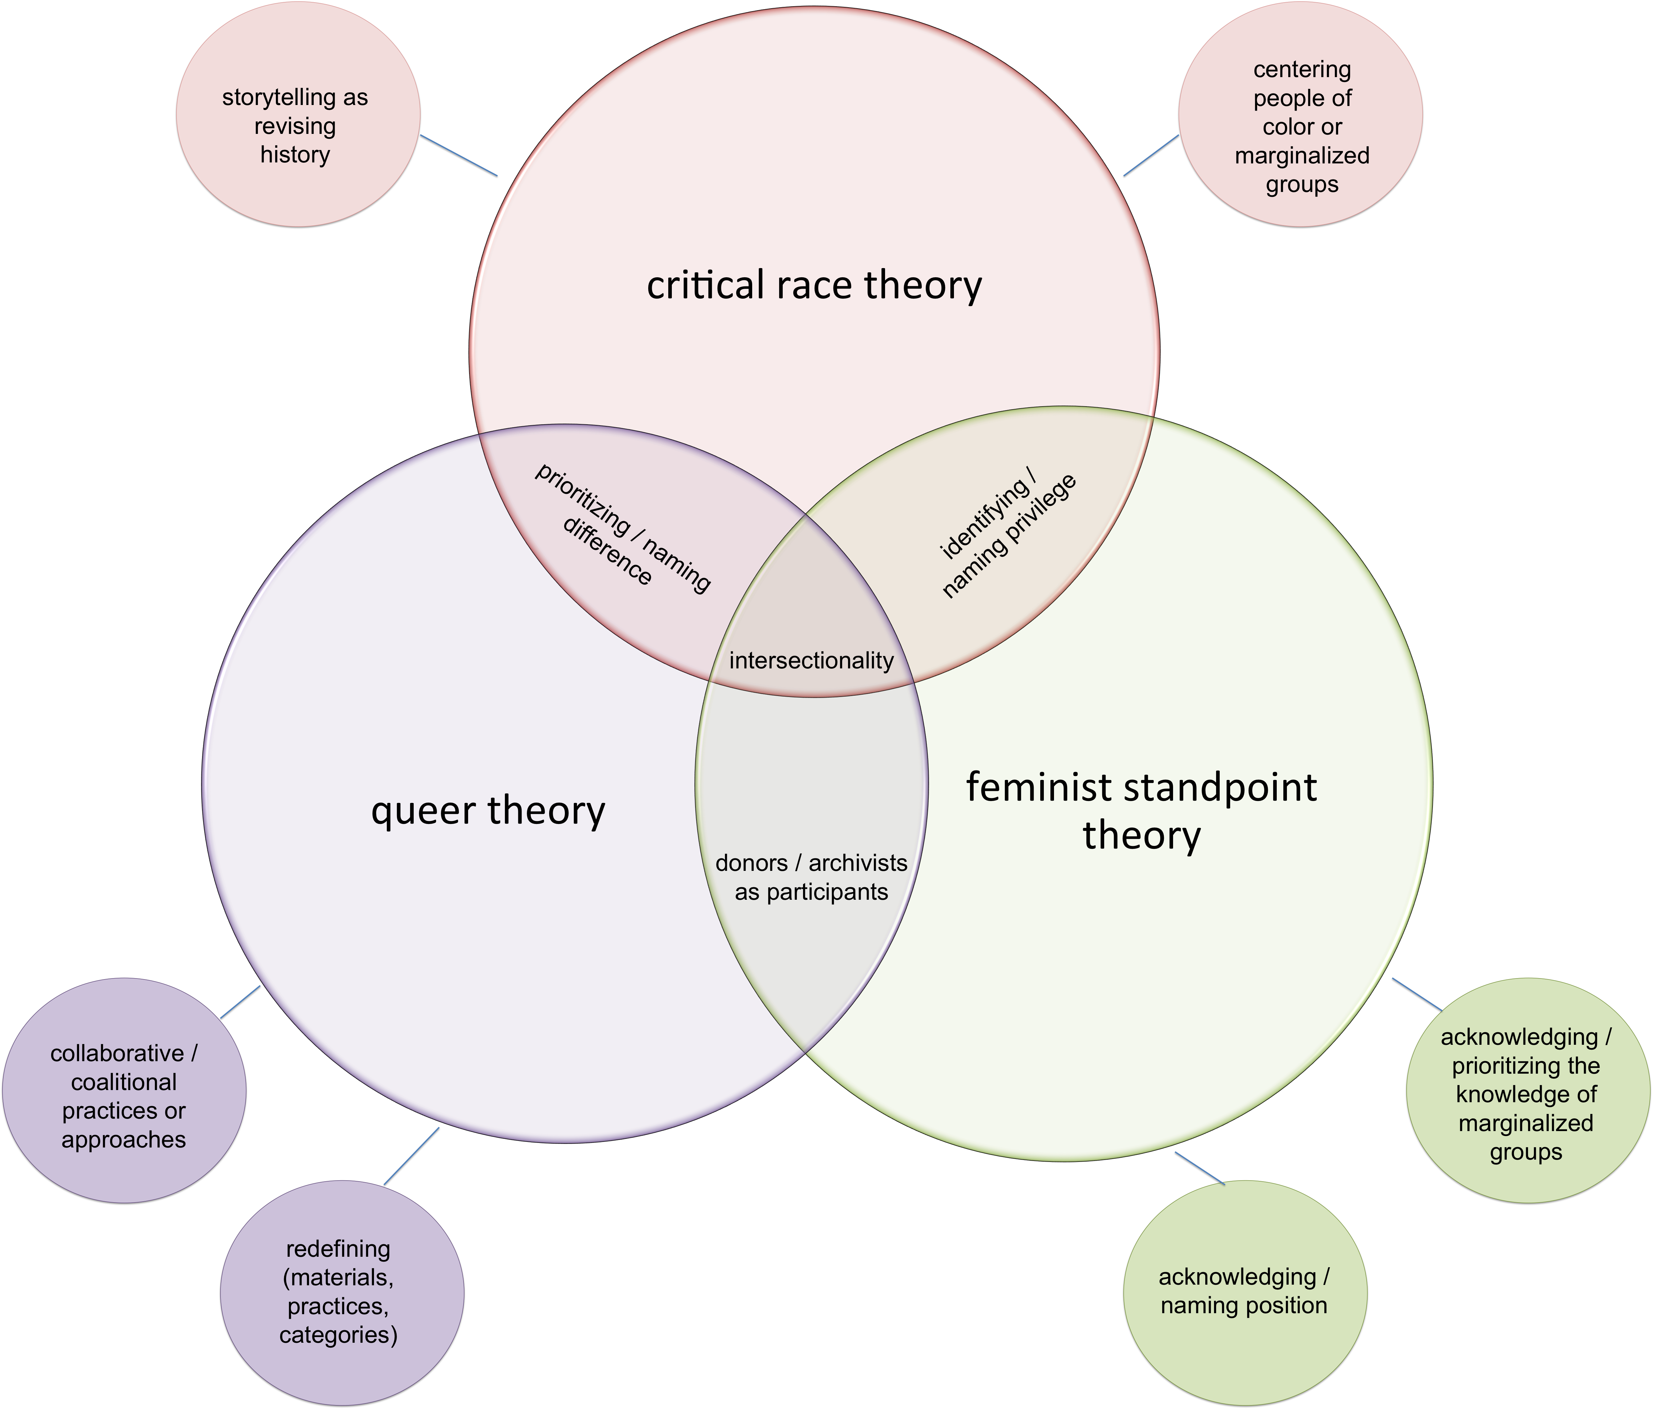
Coding Schema

Slide 7
Results
all interviewees exhibited some characteristics of each theoretical framework in their descriptions of their approaches to the work
each interviewee also identified challenges that a more intentional application of this combined theory could alleviate
Notes:
challenges identified:
-trust and relationship building w/ community
-archival establishment’s ideas of how to archive (traditional practices) that aren’t necessarily the best practices for archiving underrepresented communities (i.e. idea of “taking” and preserving vs helping to preserve the archival record)

Slide 8
Codes:
Acknowledging & Naming Privilege (CRT / FST)
Acknowledging & Naming Position (FST)
Prioritizing & Naming Difference (QT / CRT)
Centering people of color and marginalized groups (CRT)
Reflexivity
“Especially from marginalized groups. In my opinion, our society - the predominantly white community - has done a lot of taking, and we need to give back. I think that that also helps in the relationship-building process, to be clear that we’re not here to take, we’re here to work with you and we’re here to do what’s best for you and for the materials. So that’s sort of the approach that I try to take when I work with new people or organizations.”

Slide 9
Codes:
Storytelling as revising history (CRT)
Acknowledging & prioritizing the knowledge of marginalized groups (FST)
Redefining (materials, practices, categories) (QT)
Storytelling
“Well, there’s so much that’s not in the written record or the traditional record. As I said before, we thought that maybe some of these - Some people do not save material, as in papers, but they have an important story to tell, and that’s one reason for oral history. Another is that you get a very different kind of information in oral histories than you get in the written record, especially if the written record is more official or it’s more the everyday work records or council records or something like that. If you get an oral history, that really enriches the record of both. And you need both of those kinds of records.”
Notes:
oral histories as redefining
(general theme: groups not realizing that their materials are archivable / historic. archives are pushing the CRT principle of storytelling as shedding light on oppression (& expanding the story) by encouraging these groups to donate.)

Slide 10
Privilege and
relationship-
building
Codes:
Donors/Archivists as Participants (QT/FST)
Identifying & Naming Privilege (CRT / FST)
Acknowledging & Naming Position (FST)
“...marginalized groups may be more skeptical of a predominantly white institution wanting their records. So that’s part of the building in the relationship and also as you know it’s a challenge for archives to have people know about what archiving is anyway - any groups, it can be challenging to explain what we do - so that’s with almost any community, of having to go in and explain what an archive is and what we do and all of that.”

Slide 11
Implications for Practice
A more intentional application of integrated inclusivity theory can help to alleviate challenges identified by archivists working to build inclusive collections:
trust-building and relationship-building
redefining archival collections
Notes:
redefining: more flexible ideas of collections and materials will result in more inclusive collections / more communities being entered into the historical record

Slide 12
Opportunities for further research
larger sample size
inclusion of / comparison to community archives
coding language of case studies in published literature
considering other archival functions (arrangement, description, researcher access) via an integrated inclusivity theory

Slide 13
Questions?

