Slide 1
The Legacy of Lady Bountiful
White Women in the Library
Gina Schlesselman-Tarango
California State University, San Bernardino

Slide 2
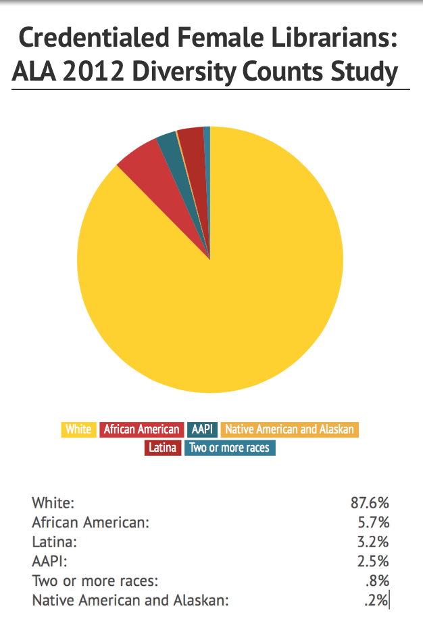
Female librarians

Slide 3
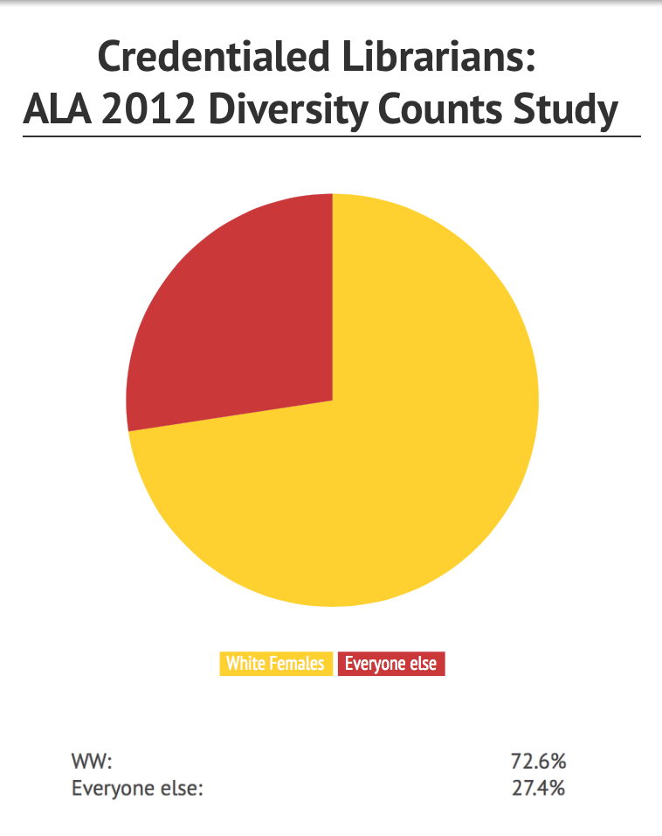
LIS is more than just feminized.
What do we make of the white female body in LIS?
What does the overwhelming presence of white women signal?

Slide 4
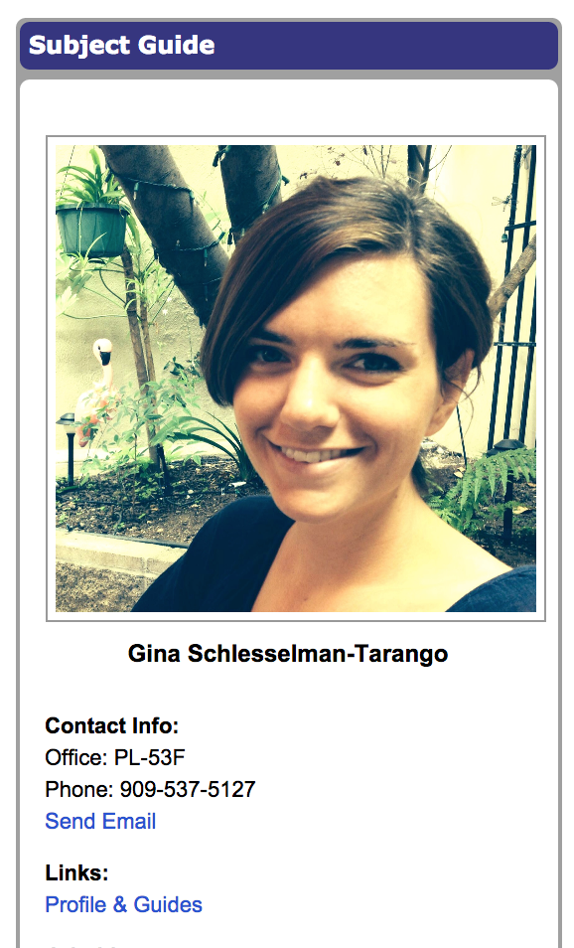
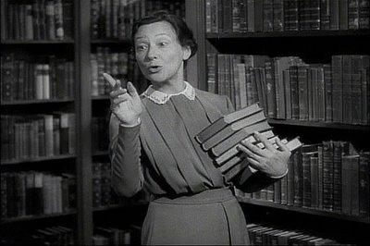
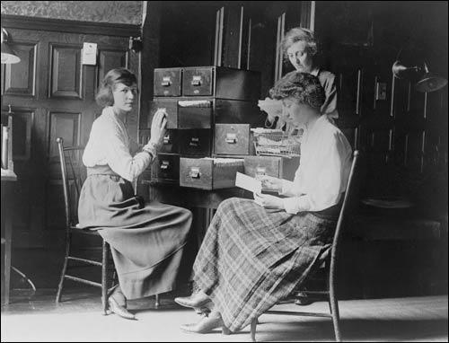
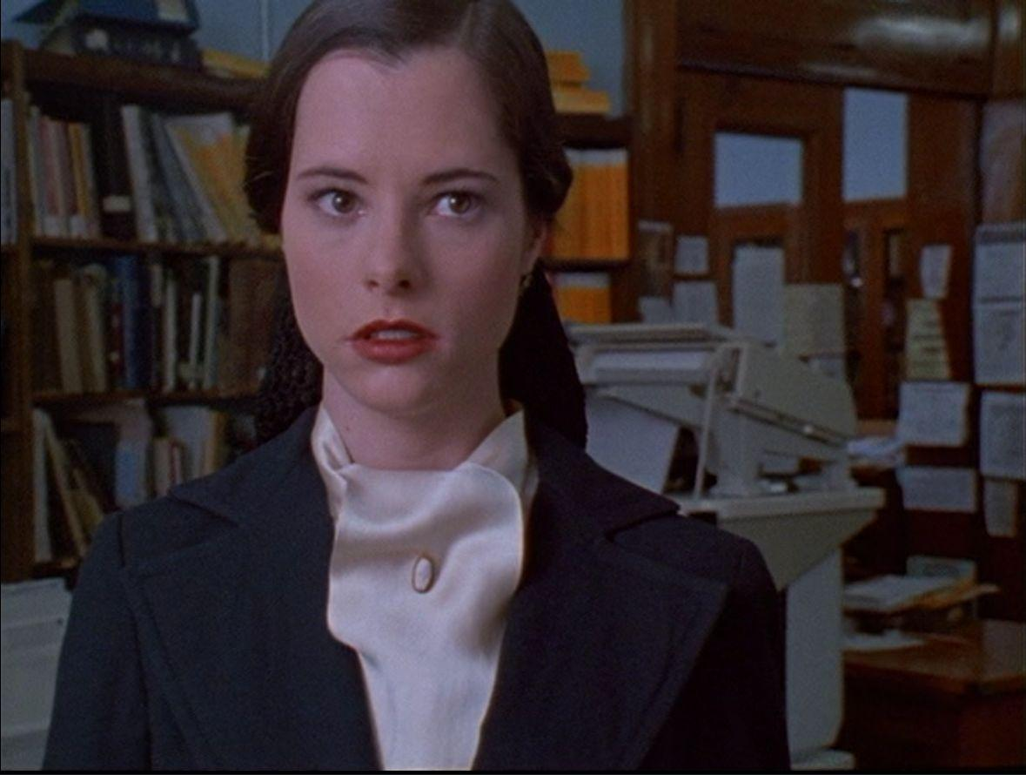
Race + Gender in LIS
“An ungendered analysis of whiteness and a white-absent, let alone colorblind, analysis of gender...will be limited in their scope and ability.”
Leonardo, Z., & Boas, E. (2013). Other kids' teachers: What children of color learn from white women and what this says about race, whiteness, and gender. In M. Lynn and A. Dixson (Eds.), Handbook of critical race theory in education (313-323). New York: Routledge.

Slide 5
Thinking about whiteness in female form
Lady Bountiful
England colonies
Missionary or teacher, civilizing force
Ideal or true woman
Role distinct from that of white men, but reinforces underlying ideologies of colonialism
Imperialism + paternalism + race + gender + notions of ideal femininity = work of colonialism & white supremacy in feminized form

Slide 6
Early Librarians/Library Workers
Feminine traits made women ideal library workers
Moral and spiritual superiority
Ability to educate, uplift, and civilize
Missionary-mindedness
White women embodied library as a civilizing institution and site of intellectual development, citizenship, and democracy

Slide 7
True Womanhood only available to white women
“Breeding and background” a criteria for entry into early library schooling
Went hand-in-hand with other feminine“personality” traits
“We have always known that the socially constructed image of innocent white womanhood relies on the continued production of the racist/sexist sexual myth that black women are not innocent and never can be.”
hooks, b. (2013). (1992/1998). Madonna: Plantation mistress or soul sister. In Roediger, D.R. (Ed.), Black on white: Black writers on what it means to be white (307-316). New York: Schocken Books.
.

Slide 8
Lady Bountiful in LIS: Past
Specific roles in racial projects
Work with children – Americanization/assimilation of European ethnics
Sanctioned capitalism, enforced traditional gender roles, encouraged deference to authority
White women “drafted to carry out the reproductive work of whiteness.”
Leonardo, Z., & Boas, E. (2013). Other kids' teachers: What children of color learn from white women and what this says about race, whiteness, and gender. In M. Lynn and A. Dixson (Eds.), Handbook of critical race theory in education (313-323). New York: Routledge.

Slide 9
Lady Bountiful in LIS: Present
Pawley (2006)
Mission/service and society/culture models
library a mission
library as educative and civilizing site
cultural uplift and citizenship
Consider patrons “as deficient and in need of remediation by (normally white) librarians”
Controlled vocabularies posit minority groups as needy Others, normalize whiteness
Models evoke notions that have historically been tied to work of white women in libraries
Pawley. (2006). Unequal legacies: Race and multiculturalism in the LIS curriculum. The Library Quarterly, 76(2), 149-168.

Slide 10
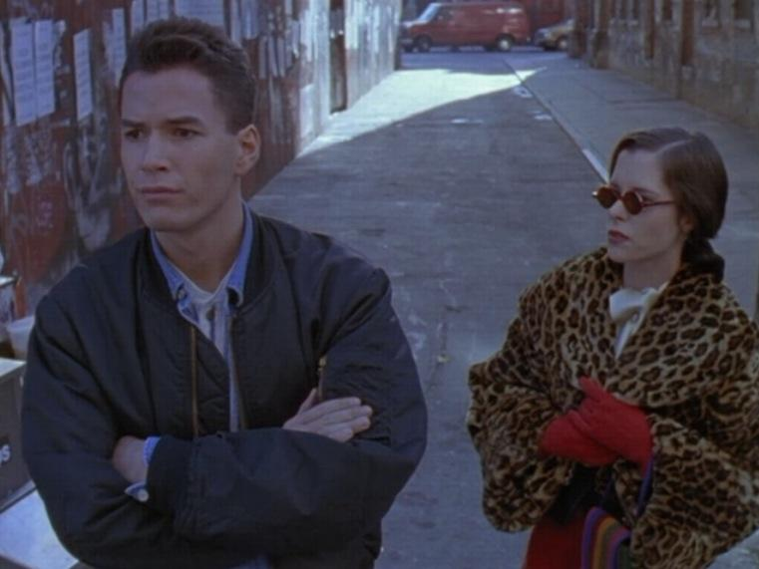
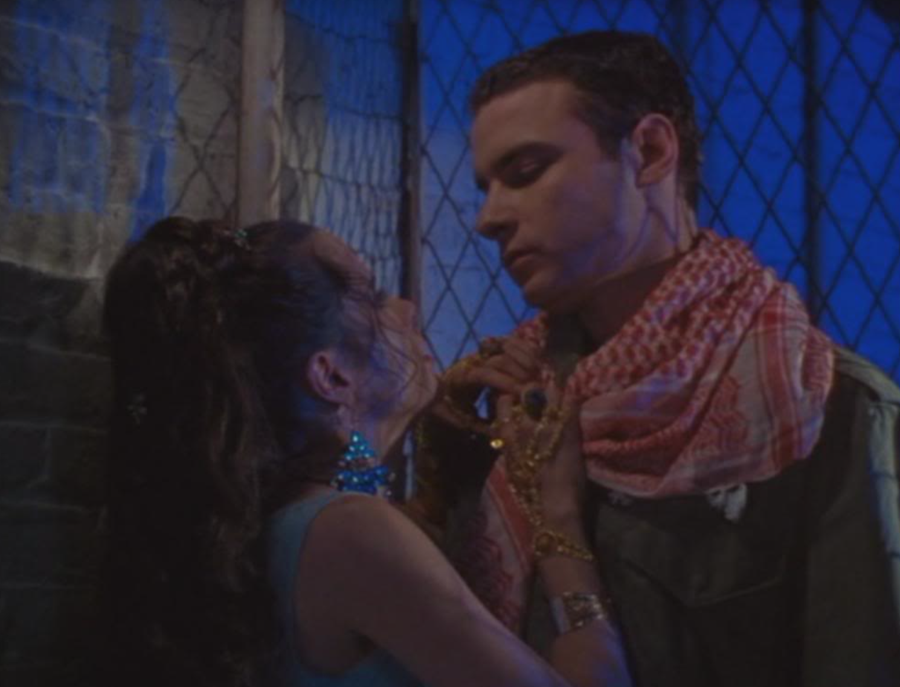
Lady Bountiful in Pop Culture

Slide 11
To think about
Is this the most readily available representation for those new to LIS?
Is she present, even among “new” or “hip” representations?
Does Lady Bountiful police the bodies that enter the field?
Does she regulate the way in which we interact with users?
How do some resist or defy the archetype, individually and/or institutionally?

Slide 12
Banishing Lady Bountiful
Feminist and historical LIS research and teaching must be intersectional
Multicultural education antiracist and feminist education
Self-work: “critically reflect on racialized and gendered histories and how you are implicated in them”
Interrogate privileges
Leonardo, Z., & Boas, E. (2013). Other kids' teachers: What children of color learn from white women and what this says about race, whiteness, and gender. In M. Lynn and A. Dixson (Eds.), Handbook of critical race theory in education (313-323). New York: Routledge.

