Slide 1
The Archival Science Profession and the Underrepresented:
Enslaved Black Women in the French
Antilles, French Archives & French Attitudes
Gender and Sexuality in Information Studies Colloquium
October 18, 2014
Notes:
Introduction: My research began with a question about archival materials on enslaved black women of the French Antilles. I wanted to know where the collections of materials were, how they were organized, and how accessible they were to researchers, scholars, and the public. I soon found that I didn’t have the time and financial resources to pursue my research to the fullest. However, I found, at the time, that there was enough scholarly information to support my argument that black women have an important role in the selection, management, and preservation of materials in which they are subjects.

Slide 2
“What can a niggerwoman do but endure? What can me do but tell the story? Who is there when we recall great womens?” –Marlon James, The Book of Night Women
Notes:
This quote from Marlon James’ The Book of Night Women hints at the tradition of oral history; Black women must tell their own stories. My interest in black women as a group began with in interest in the economics of slavery. That is, what was the economic contribution of enslaved black women? My interest then expanded to the topic of the replication of hegemonic power in the culture of black women; enslaved communities of black women and black women’s clubs of the late 19th century. This led to a different paper, but I don’t want to get sidetracked. I began this current project with a brief historical survey of archival science.

Slide 3
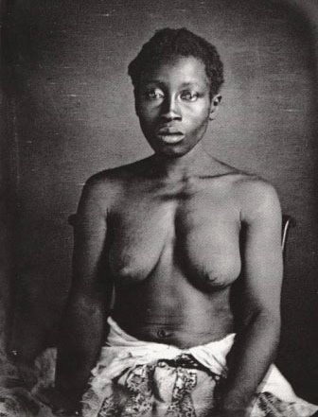
“Delia,” Enslaved Black Woman South Carolina 1850
Notes:
Historical Context: Slide 3 (“Delia” She is socially dead. Sources are limited, scattered, and invisible. Not specific to official archives.)

Slide 4
FRAMEWORK
Archival appraisal: the selection of resources that have been
determined to have lasting value.
Jenkinson/Duranti: the archivist is a neutral party.
Schwartz and Cook: the archivist has power.
Black Feminist theory: Based upon the concept of intersectionality.
Black women experience oppression through race and gender,
and there is no way to separate these interlocking social constructs.
Black feminist theorists have added class and sexuality to the ways in which black women experience oppression.
Notes:
Traditional archival practice (Positivist) vs. Postmodern archival practice. It doesn’t necessarily have to be framed this way—there should be progress and inclusivity (challenge to the traditional view of archival science.)

Slide 5
White Men
Black Men White Women
Black Women
POWER PYRAMID
Notes:
SLIDE 5: POWER PYRAMID: I learned about this in African American Literature class. This is relevant to how resources are collected and preserved. Of course this pyramid is an oversimplification, but it is generally true.
Black men can negotiate power through gender solidarity, and white women can negotiate power through racial solidarity. What do black women possess to negotiate power?

Slide 6
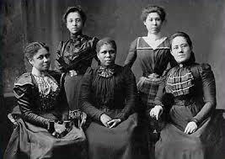
“When one is told by a librarian, archivist, professor, however well-
meaning, that “there isn’t much on the topic,” that is a way of simply
denying and erasing a particular past.” –Afua Cooper, Historian
“When Western ethnologists and collectors enter, the objects move
into another orbit of value, one determined by Europeans. In this
orbit they have a different value, higher in monetary terms than the
one they are given in their indigenous sphere.”
–Richard J. Cox, Archivist

Slide 7
AFRICAN AMERICAN ARCHIVISTS AND LIBRARIANS
1% INCREASE IN 22 YEARS
Diversity Counts Report (ALA)
http://www.ala.org/offices/diversity/diversitycounts/divcounts.
Accessed 19 Sept. 2014.
Notes:
This stagnation in recruitment suggests exclusion and intolerable working conditions.

Slide 8
PROBLEMS
RECRUITMENT: Bad public relations. If current black archivists and librarians are having a difficult time in the field, they will not refer others.
RETENTION: If black archivists and librarians continuously experience direct and indirect racism (microaggressions) from patrons and co-workers, they will eventually leave the profession.
Curry, D.A.(1994). Your worries ain’t like mine: African American librarians and the pervasiveness of racism, prejudice and discrimination in academe. The Reference Librarian 21 (45-46), 299-311
SOLUTIONS
MUST BE INSTITUTIONALIZED:
DIVERSITY IN ARCHIVAL AND LIS
CURRICULUM.
HONEST CONFRONTATION OF BIAS AND RACISM/SEXISM→SELF-REFLEXIVE PRACTICE.
BLACK LEADERSHIP

Slide 9
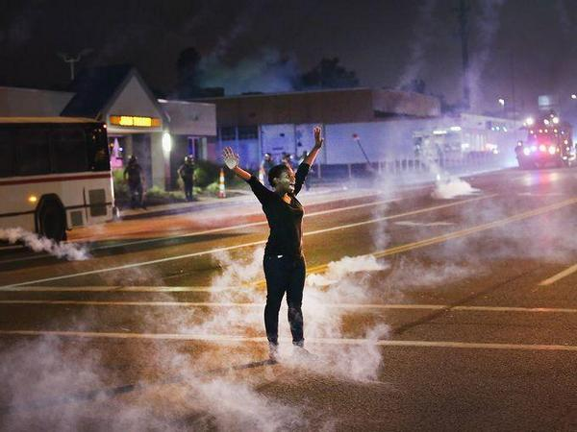
Ferguson, Missouri August 2014
Notes:
CONCLUSION: Historically, black women have been on the front lines during civil unrest. They have been administrators, organizers, and rebels (Black women planned slave rebellions, etc.). Because black women are oppressed through different identities, they are a unique group. As a result, when black women triumph many other groups triumph.
Through research on archival collections of enslaved black women in the French Antilles, I wanted to analyze the global lack of diversity—specifically the low numbers of black women working in archives and LIS—using appraisal theory, Black Feminist theory and archives and power as a framework. Looking at the 2010 American Library Association’s diversity report, I was compelled to explore the reasons why after 22 years there had been no progress in recruitment and retention in archives and LIS—we tend to discuss these problems, but we don’t take effective, meaningful action (scholarships are not enough when the tools and networking systems cannot be exploited in the same ways the dominant culture exploits them. This group is often being excluded from employment, as well.) The scattered sources on enslaved black women allude to the state of black women in the fields of archival science and library and information science.

Slide 10
Reference Images
Benoist, M-G. (1800). Portrait d’un négresse. Accessed 6 Oct 2014. http:// www.arthistoryarchive.com/arthistory/Slavery-is-a-Woman.html
“Delia.” Agassiz Zealy slave portraits. Accessed 10 Oct 2014. http:// commons.wikimedia.org/wiki Category:Agassiz_Zealy_slave_portraits.
Olson, S. (2014). Unknown woman: Ferguson, Missouri protest. Getty Images.
Library of Congress. (1900). Five Officers of the Women’s League. LC- USZ62-51555. Accessed 6 Oct 2014. https://www.nwhm.org/html/exhibits/ progressiveera/africanamericanreform.html

